Slide 1
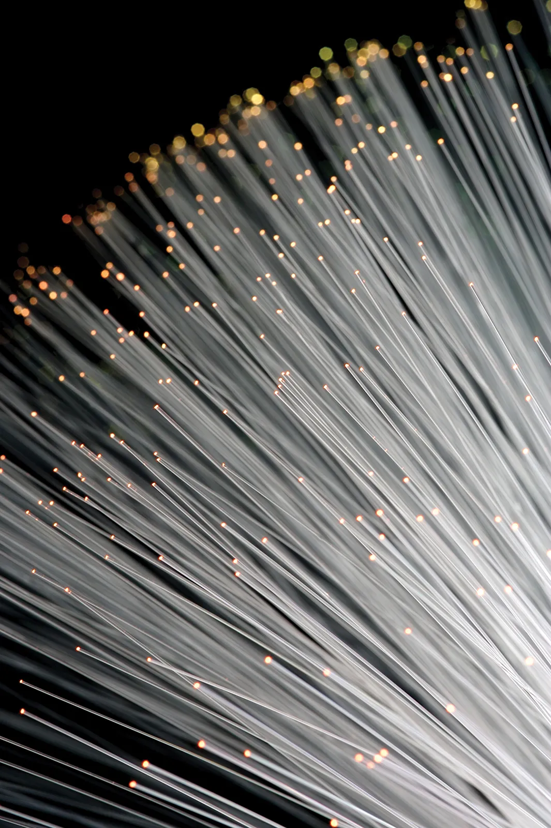
WELCOME TO OUR PRESENTATION
Topic: Optics
Course Title: Physics-I
Course Code: PHY101

Slide 2

Presented To
Name: Mr. Swarup Podder
Designation: Lecturer
Department: Computer Science and Engineering
Faculty: Faculty of Science and Information Technology
Daffodil International University.

Slide 3




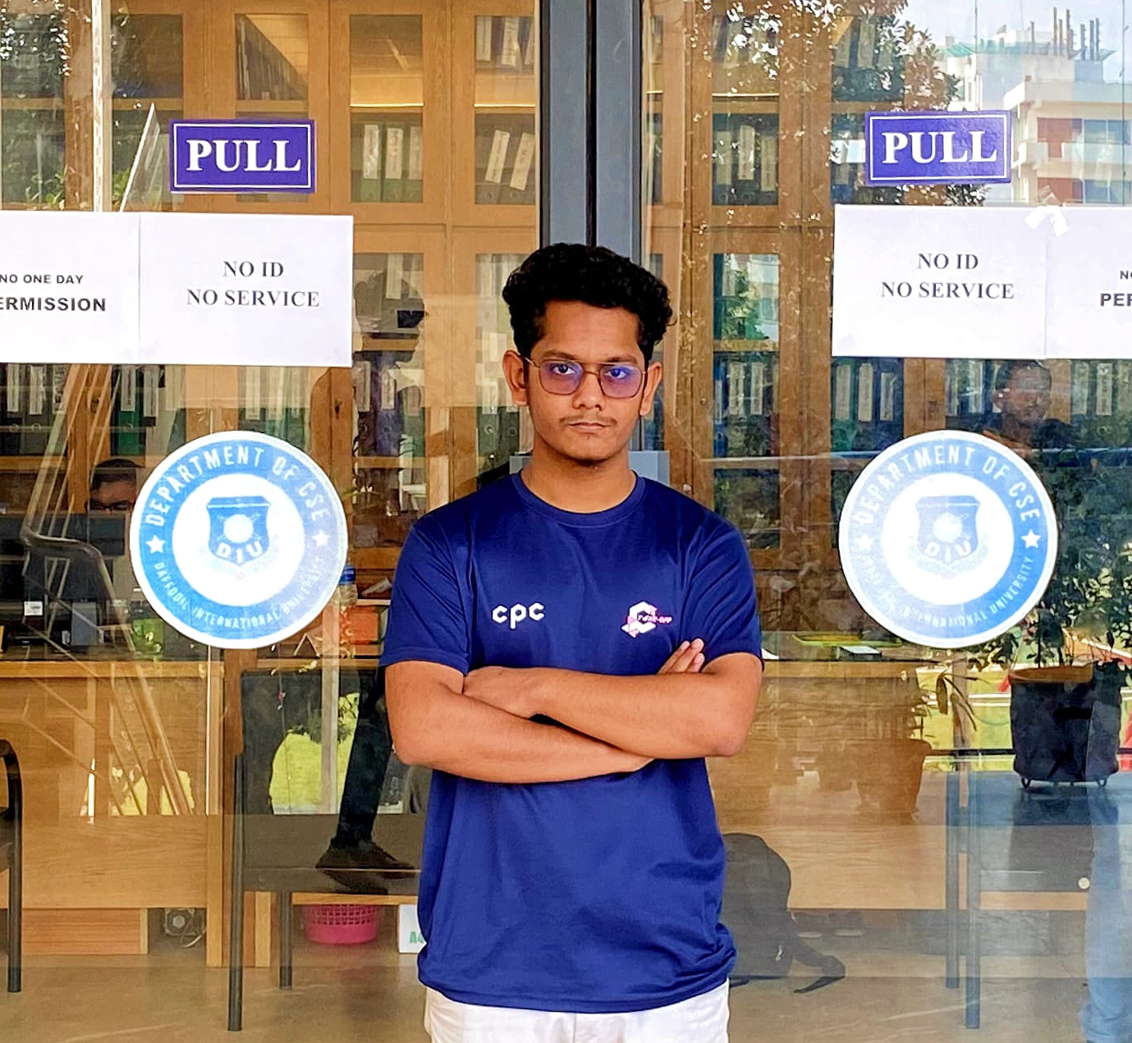
Our Team
Md Shadman Siyam
Sagor Das
Supan Roy
ID: 232-15-387
ID: 232-15-294
ID: 232-15-716
Md Yeasin Shazad Peal
Mahfuz Ahammed Hanif
ID: 232-15-102
ID: 232-15-465

Slide 4
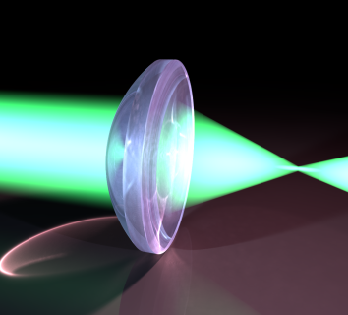
Area Covered
Concept of historical background of Optics
Theoretical background of optics (4 theories of light)
Reflection
Refraction
Total internal reflection
Critical angle

Slide 5
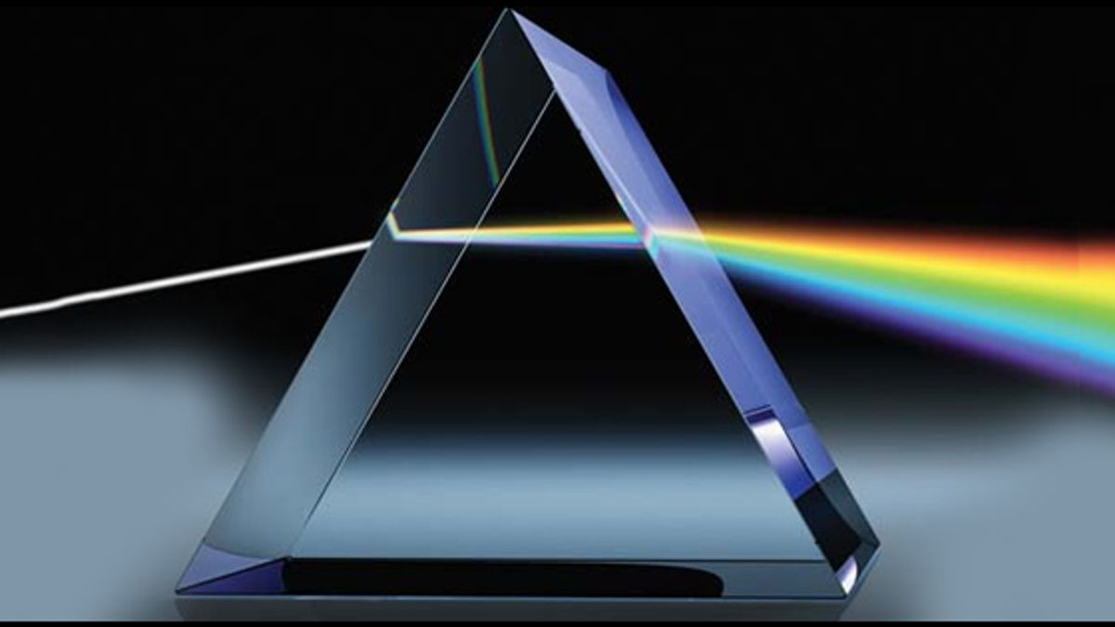
Introduction
Optics is the branch of physics which involves the behavior and properties of light, including its interactions with matter and the construction of instruments that use or detect it.
Optics usually describes the behavior of visible, ultraviolet, and infrared light. Because light is an electromagnetic wave, other forms of electromagnetic radiation such as X-rays, microwaves, and radio waves exhibit similar properties.

Slide 6
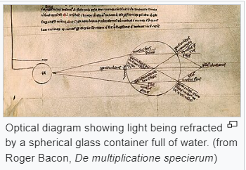
Concept of historical background of Optics
Optics began with the development of lenses by the ancient Egyptians and Mesopotamians, followed by theories on light and vision developed by ancient Greek philosophers, and the development of geometrical optics in the Greco-Roman world.
Optics was significantly reformed by the developments in the medieval Islamic world, such as the beginnings of physical and physiological optics, and then significantly advanced in early modern Europe, where diffractive optics began. These earlier studies on optics are now known as "classical optics". The term "modern optics" refers to areas of optical research that largely developed in the 20th century, such as wave optics and quantum optics.

Slide 7
Theoretical background of optics (4 theories of light)
The theoretical understanding of light has evolved over centuries, with various theories proposed to explain its nature. Here are four key theories of light:
Newton’s corpuscular theory of light
Newton’s corpuscular theory of light is based on the following points:
1. Light consists of very tiny particles known as “corpuscular”.
2. These corpuscles on emission from the source of light travel in straight line with high velocity.
3. When these particles enter the eyes, they produce image of the object or sensation of vision.
4. Corpuscles of different colors have different sizes.

Slide 8
Theoretical background of optics (4 theories of light)
The theoretical understanding of light has evolved over centuries, with various theories proposed to explain its nature. Here are four key theories of light:
Huygens’s wave theory of light
Christian Huygens proposed the wave theory of light. According to Huygens’s wave theory:
1. Each point in a source of light sends out waves in all directions in hypothetical medium called "ETHER".
2. Light is a form of energy.
3. Light travels in the form of waves.
4. A medium is necessary for the propagation of waves & the whole space is filled with an imaginary medium
called Ether
5. Light waves have very short-wave length.

Slide 9
Theoretical background of optics (4 theories of light)
The theoretical understanding of light has evolved over centuries, with various theories proposed to explain its nature. Here are four key theories of light:
Quantum theory of light
Quantum theory was put forward by MAX-PLANCK in 1905. According to quantum theory
“Energy radiated or absorbed cannot have any fractional value. This energy must be an integral multiple of a fixed quantity of energy. This quantity is called “QUANTUM”

Slide 10
Theoretical background of optics (4 theories of light)
The theoretical understanding of light has evolved over centuries, with various theories proposed to explain its nature. Here are four key theories of light:
Electromagnetic theory
Proponents: James Clerk Maxwell.
Key Idea: Light is an electromagnetic wave. Maxwell's equations, formulated in the mid-19th century, showed that varying electric and magnetic fields could propagate through space as a self-sustaining wave.
Significance: Maxwell's electromagnetic theory of light successfully unified electricity and magnetism and predicted the existence of electromagnetic waves, including light. This theory laid the foundation for understanding light as part of the electromagnetic spectrum.

Slide 11
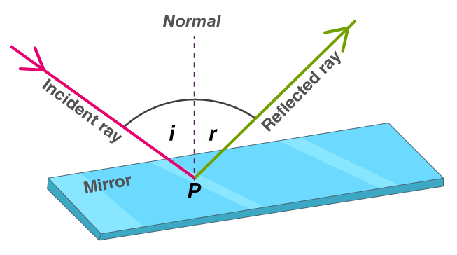
Reflection of Light
When a ray of light approaches a smooth polished surface and the light ray bounces back, it is called the reflection of light. The incident light ray that land on the surface is reflected off the surface. The ray that bounces back is called the reflected ray. If a perpendicular were drawn on a reflecting surface, it would be called normal. The figure below shows the reflection of an incident beam on a plane mirror.
Here, the angle of incidence and angle of reflection are with respect to normal and the reflective surface.
Laws of Reflection
The laws of reflection determine the reflection of incident light rays on reflecting surfaces, like mirrors, smooth metal surfaces and clear water. Let’s consider a plane mirror as shown in the figure above. The law of reflection states that
The incident ray, the reflected ray and the normal all lie in the same plane
The angle of incidence = Angle of reflection
Fig 1: Reflection of light

Slide 12
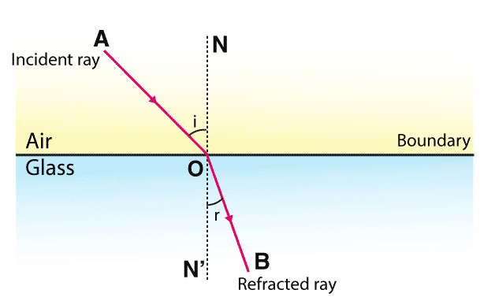
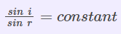
Refraction of Light
Refraction of light is one of the most commonly observed phenomena, but other waves like sound waves and water waves also experience refraction. Refraction makes it possible for us to have optical instruments such as magnifying glasses, lenses and prisms. It is also because of the refraction of light that we are able to focus light on our retina.
Laws of Refraction of Light
Laws of refraction state that:
The incident ray refracted ray, and the normal to the interface of two media at the point of incidence all lie on the same plane.
The ratio of the sine of the angle of incidence to the sine of the angle of refraction is constant. This is also known as Snell’s law of refraction.
Fig 2: Refraction of light

Slide 13
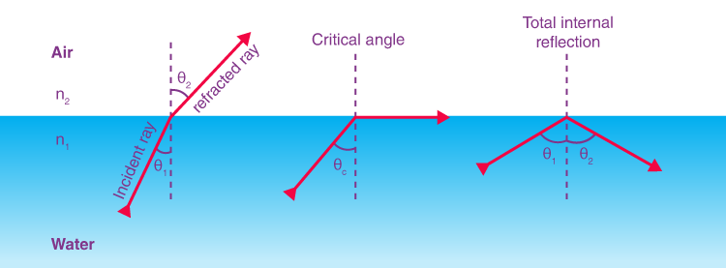
Total Internal Reflection
Total internal reflection is defined as:
The phenomenon which occurs when the light rays travel from a more optically denser medium to a less optically denser medium.
Consider the following situation. A ray of light passes from a medium of water to that of air. Light ray will be refracted at the junction separating the two media. Since it passes from a medium of a higher refractive index to that having a lower refractive index, the refracted light ray bends away from the normal. At a specific angle of incidence, the incident ray of light is refracted in such a way that it passes along the surface of the water. This particular angle of incidence is called the critical angle. Here the angle of refraction is 90 degrees. When the angle of incidence is greater than the critical angle, the incident ray is reflected back to the medium. We call this phenomenon total internal reflection.
Fig 3: Total internal Reflection

Slide 14
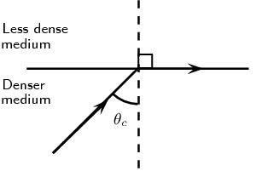
Critical Angle
The critical angle is the angle of incidence to which the angle of refraction is equivalent to 90°.
When light enters a denser media from such a comparably rarer medium, the orientation of light changes as well as the light beam bending towards the normal.
Absolute internal reflection is the complete reflection of such a light beam from the surrounding medium directly into a fluid medium as well as glasses.
This only happens whenever a light beam would be in a dense medium as well as approaches a much less dense media, whenever the light ray's angle of incidence is larger than the critical angle.
Fig 4: Critical angle

Slide 15
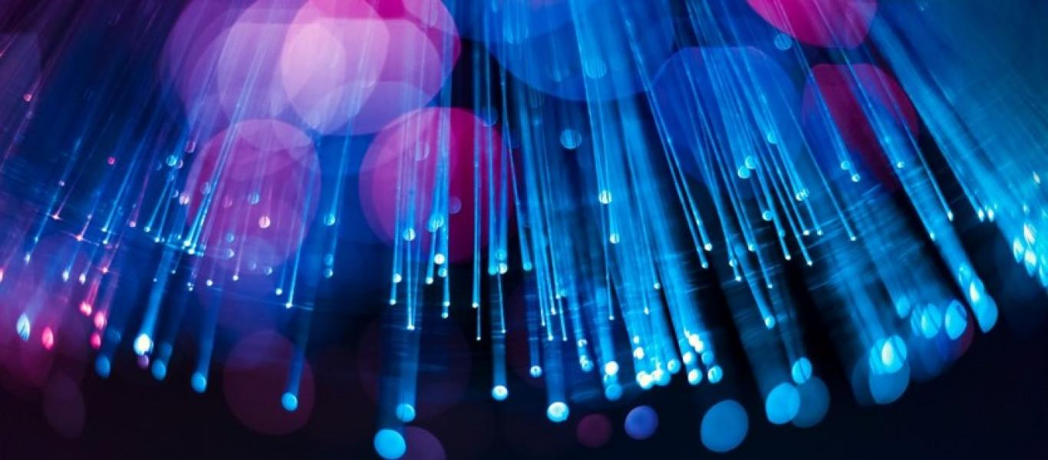

Thank you

